Slide 1
Stories about Consulting

Slide 2


Slide 3




Slide 4
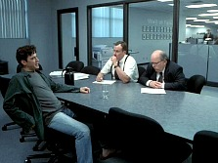


Slide 5


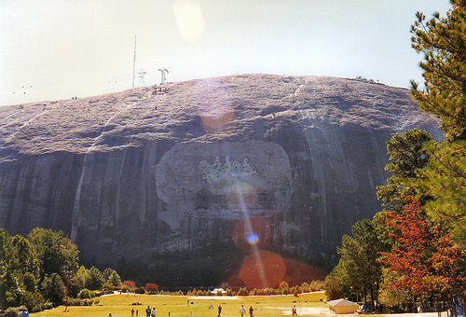



Slide 6
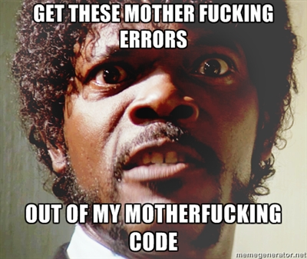

Slide 7
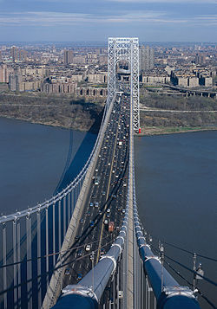


Slide 8


Slide 9



Slide 10
Move
Talk
Think

Slide 11




Slide 12
End of Story

